Slide 1

Notes:
Generated lesson slide based on the uploaded handout: Title: When Life Changes, God Does Not

Slide 2
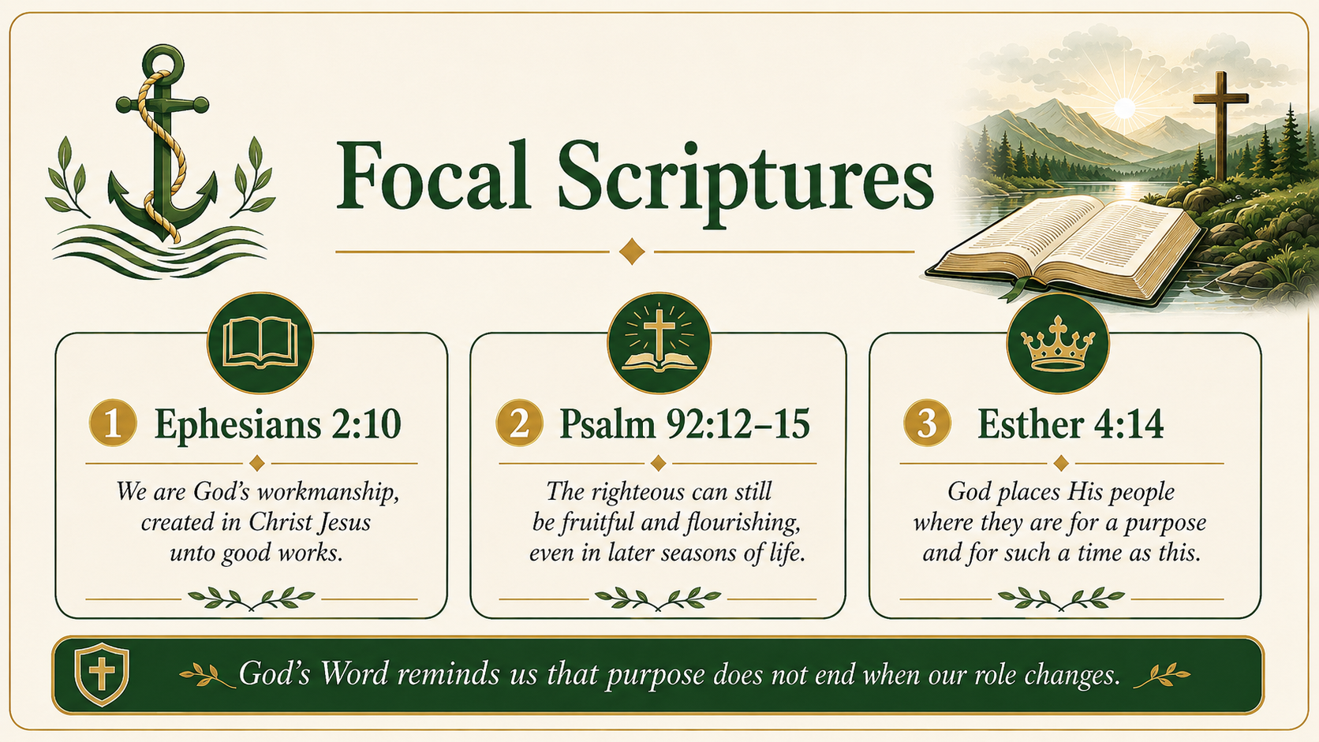
Notes:
Generated lesson slide based on the uploaded handout: Focal Scriptures

Slide 3
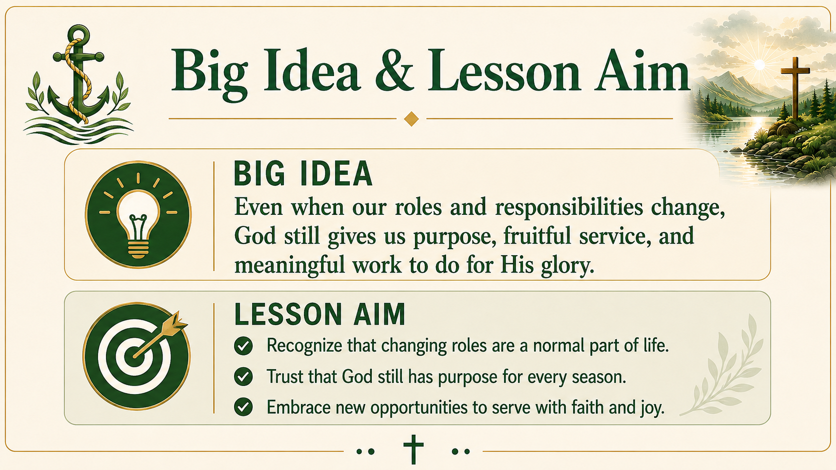
Notes:
Generated lesson slide based on the uploaded handout: Big Idea & Lesson Aim

Slide 4

Notes:
Generated lesson slide based on the uploaded handout: Opening Thought

Slide 5

Notes:
Generated lesson slide based on the uploaded handout: Teaching Truth 1

Slide 6

Notes:
Generated lesson slide based on the uploaded handout: Teaching Truth 2

Slide 7

Notes:
Generated lesson slide based on the uploaded handout: Teaching Truth 3

Slide 8

Notes:
Generated lesson slide based on the uploaded handout: Discussion, Key Takeaway & Closing Prayer

