Slide 1

Notes:
Chronological sequence slide 1 of 9: Title slide: Beyond Sunday Lesson 3.
[Sources]
Generated slide image based on the user-provided Lesson 3 student handout images in this conversation.

Slide 2
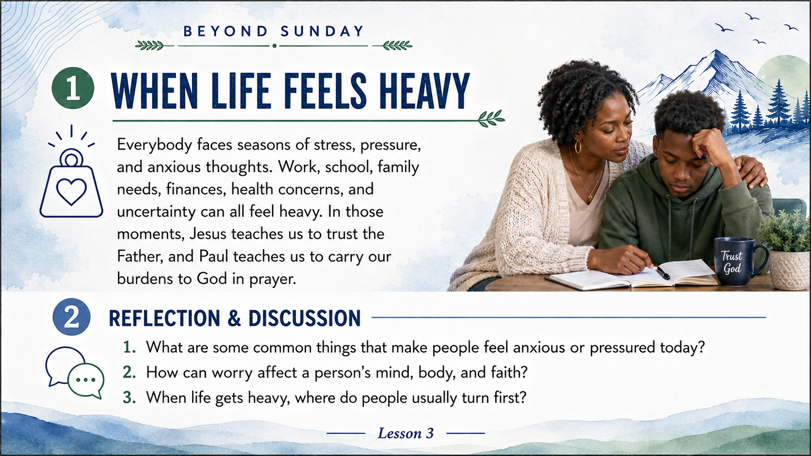
Notes:
Chronological sequence slide 2 of 9: Sections 1-2: When Life Feels Heavy; Reflection & Discussion.
[Sources]
Generated slide image based on the user-provided Lesson 3 student handout images in this conversation.

Slide 3
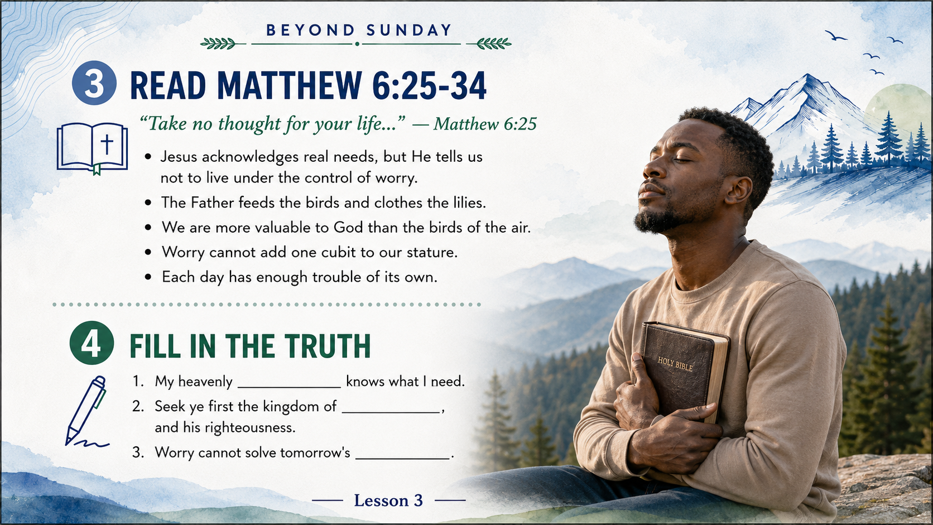
Notes:
Chronological sequence slide 3 of 9: Sections 3-4: Read Matthew 6:25-34; Fill in the Truth.
[Sources]
Generated slide image based on the user-provided Lesson 3 student handout images in this conversation.

Slide 4
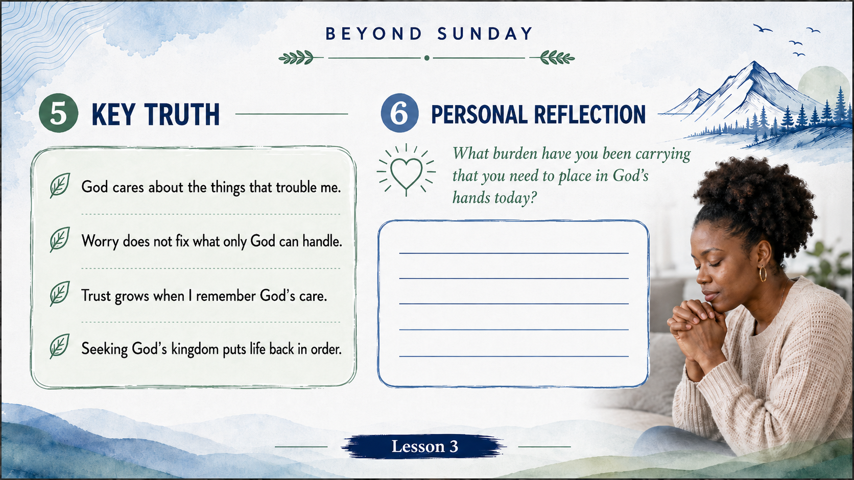
Notes:
Chronological sequence slide 4 of 9: Sections 5-6: Key Truth; Personal Reflection.
[Sources]
Generated slide image based on the user-provided Lesson 3 student handout images in this conversation.

Slide 5

Notes:
Chronological sequence slide 5 of 9: Sections 7-8: Read Philippians 4:4-9; Fill in the Truth.
[Sources]
Generated slide image based on the user-provided Lesson 3 student handout images in this conversation.

Slide 6

Notes:
Chronological sequence slide 6 of 9: Section 9: From Pressure to Peace.
[Sources]
Generated slide image based on the user-provided Lesson 3 student handout images in this conversation.

Slide 7

Notes:
Chronological sequence slide 7 of 9: Section 10: Application.
[Sources]
Generated slide image based on the user-provided Lesson 3 student handout images in this conversation.

Slide 8

Notes:
Chronological sequence slide 8 of 9: Section 11: 7-Day Challenge.
[Sources]
Generated slide image based on the user-provided Lesson 3 student handout images in this conversation.

Slide 9
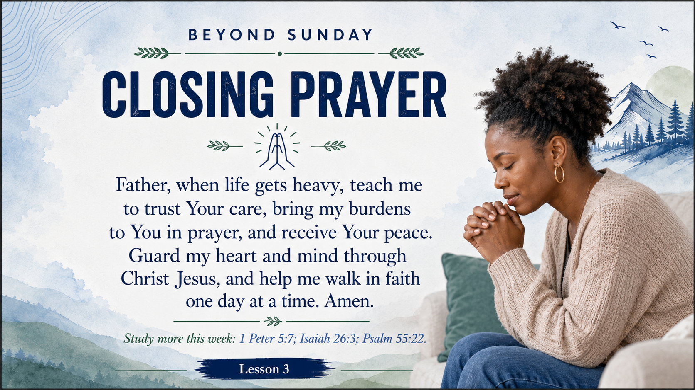
Notes:
Chronological sequence slide 9 of 9: Section 12: Closing Prayer.
[Sources]
Generated slide image based on the user-provided Lesson 3 student handout images in this conversation.

